Slide 1
UN and CLIMATE CHANGE
[UN Photo]
Notes:
Information Source:
United Nations website: www.un.org/climate change/the_science/
Photo source:
http://www.un.org/climatechange/blog/2014/03/ipcc-report-severe-and-pervasive-impacts-of-climate-change-will-be-felt-everywhere/

Slide 2
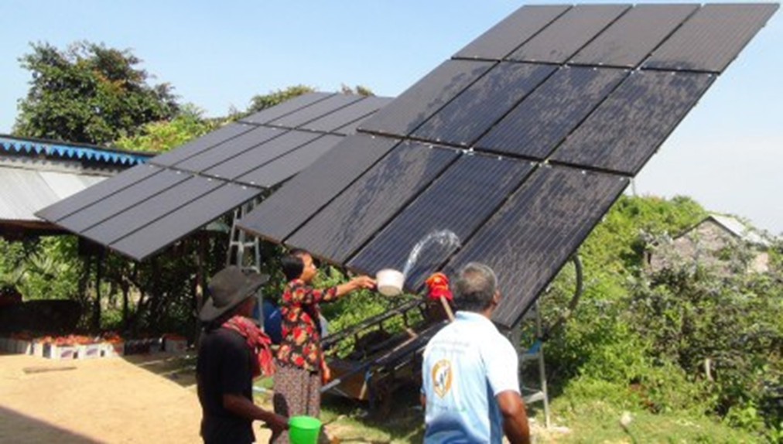
Publication Details:
This resource has been prepared by Rees D. Barrett, Education Convenor, (UNAAWA) as part of a project originated by Karissa Wilson, Environmental Forum Convenor.
Feedback from teachers will be gratefully received and used in the review of this resource.
© 2015 United Nations Association of Australia – WA Division.
Villagers in Cambodia clean the solar panels they use to recharge batteries for electricity
[UNDP Photo]
Notes:
First approved July 2015 (v1.1), reviewed July 2016 (v2.1), next review by July 2017
Western Australian Curriculum links - Content: Year 6 Geography; Year 6 Civics and Citizenship. Cross curriculum Priority – Sustainability. Generic Capabilities: Critical and Creative Thinking. Values: Environmental Responsibility.
Photo Source:
http://www.un.org/climatechange/blog/2014/08/solar-stations-cambodia/

Slide 3
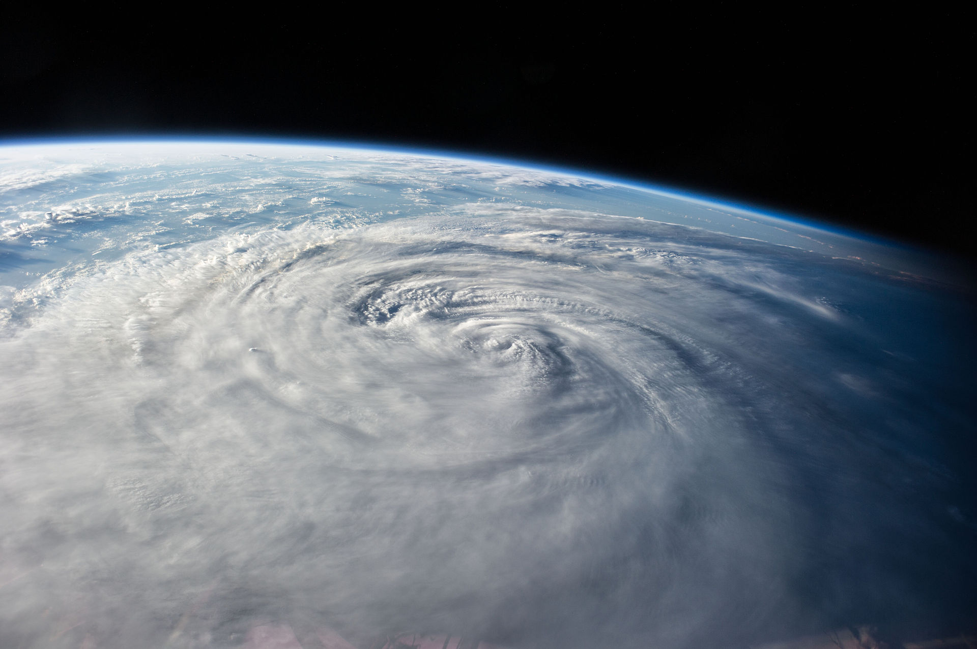
What is Climate?
Climate is the generalised weather (state of the atmosphere) averaged over an extended period (at least 10 years).
Global climate is an averaging of climate over all points on planet earth (spatial average).
[NASA Photo]
Notes:
Teacher Notes:
Students could research changes that have occurred to earth’s climate in the past. For example, the ice ages.
The Industrial Revolution has resulted in increased use of fossil fuels (coal, oil and natural gas). An environmental effect of high-carbon industrialisation is to move carbon from underground into the air.
Students could research the different climate systems on earth and ways in which they are predicted to change.
Photo Source:
"ISS-40 Typhoon Halong" by NASA - http://www.flickr.com/photos/nasa2explore/14844170921/. Licensed under Public Domain via Wikimedia Commons - https://commons.wikimedia.org/wiki/File:ISS-40_Typhoon_Halong.jpg#/media/File:ISS-40_Typhoon_Halong.jpg

Slide 4
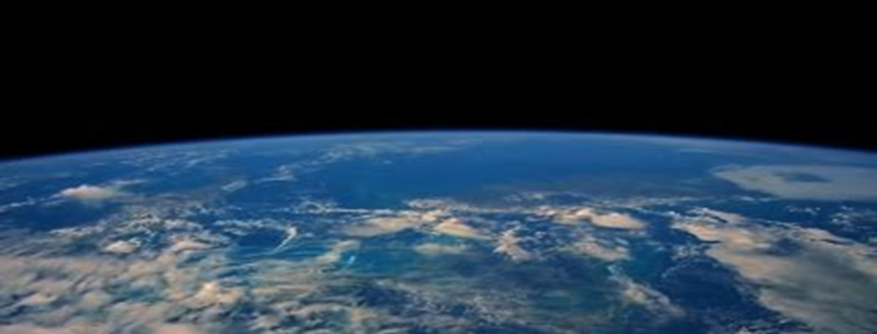
What is Climate Change?
Climate change is long term change in earth’s climate systems.
Our planet has always experienced climate change and over the last 10,000 years has been warming.
Climate scientists are concerned that the speed of warming has sped up in the last 250 years. This is the period of the Industrial Revolution.
[UN Photo]
Notes:
Teacher Notes:
Students could research changes that have occurred to earth’s climate in the past. For example, the ice ages.
The Industrial Revolution has resulted in increased use of fossil fuels (coal, oil and natural gas). An environmental effect of high-carbon industrialisation is to move carbon from underground into the air.
Students could research the different climate systems on earth and ways in which they are predicted to change.
Photo Source:
http://www.unep.org/

Slide 5
A Controversial Issue
The large majority of experts argue that scientific evidence proves more rapid climate change has been caused by human activity.
These experts are optimistic that the harmful effect of climate change will be reduced by all countries changing human activity now.
Others argue that the earth’s climate has always changed. Humans are not the cause. There is no need to change human activities now.
Notes:
Teacher Notes:
It is important to achieve an appropriate balance in presenting the controversial nature of climate change. The scientific evidence presented through the IPCC confirms that human activity is the key. The optimistic note is that swift, significant, global action over the next generation can avert ‘dire’ consequences.
Students can verify the scientific evidence presented in this PowerPoint through the United Nations website: www.un.org/climate change/the_science/
Students can also research the reasons why others in their community may hold different views.

Slide 6
2015 Paris Conference
2015 is seen to be ‘pivotal’ for achieving an ambitious, global treaty responding to climate change.
A Conference of all 193 members of the United Nations in Paris December 2015 will seek a commitment to urgent action.
“We have no time to waste, and much to gain by moving quickly down a lower-carbon pathway. All countries must be part of the solution if we are to stay below the 2 degrees Celsius temperature rise threshold.”
Ban Ki Moon, UN Secretary General, 23 February 2015
Notes:
Source:
http://www.un.org/climatechange/blog/2015/02/2015-pivotal-finalizing-universal-climate-change-agreement-ban-tells-member-states/

Slide 7
IPCC
The UN set up the Intergovernmental Panel on Climate Change (IPCC) in which thousands of the world’s scientists review climate change research.
The IPCC provides a forum for understanding the causes and impact of rapid global warming.
In 2007 the IPCC won the Nobel Peace prize.
[UN Photo]
Notes:
Teacher Notes:
Students could research some of the conclusions, agreed by over 95% of the world’s climate scientists through the Intergovernmental Panel on Climate Change. Refer to http://www.un.org/climatechange/blog/2014/10/ipcc-media-advisory/

Slide 8
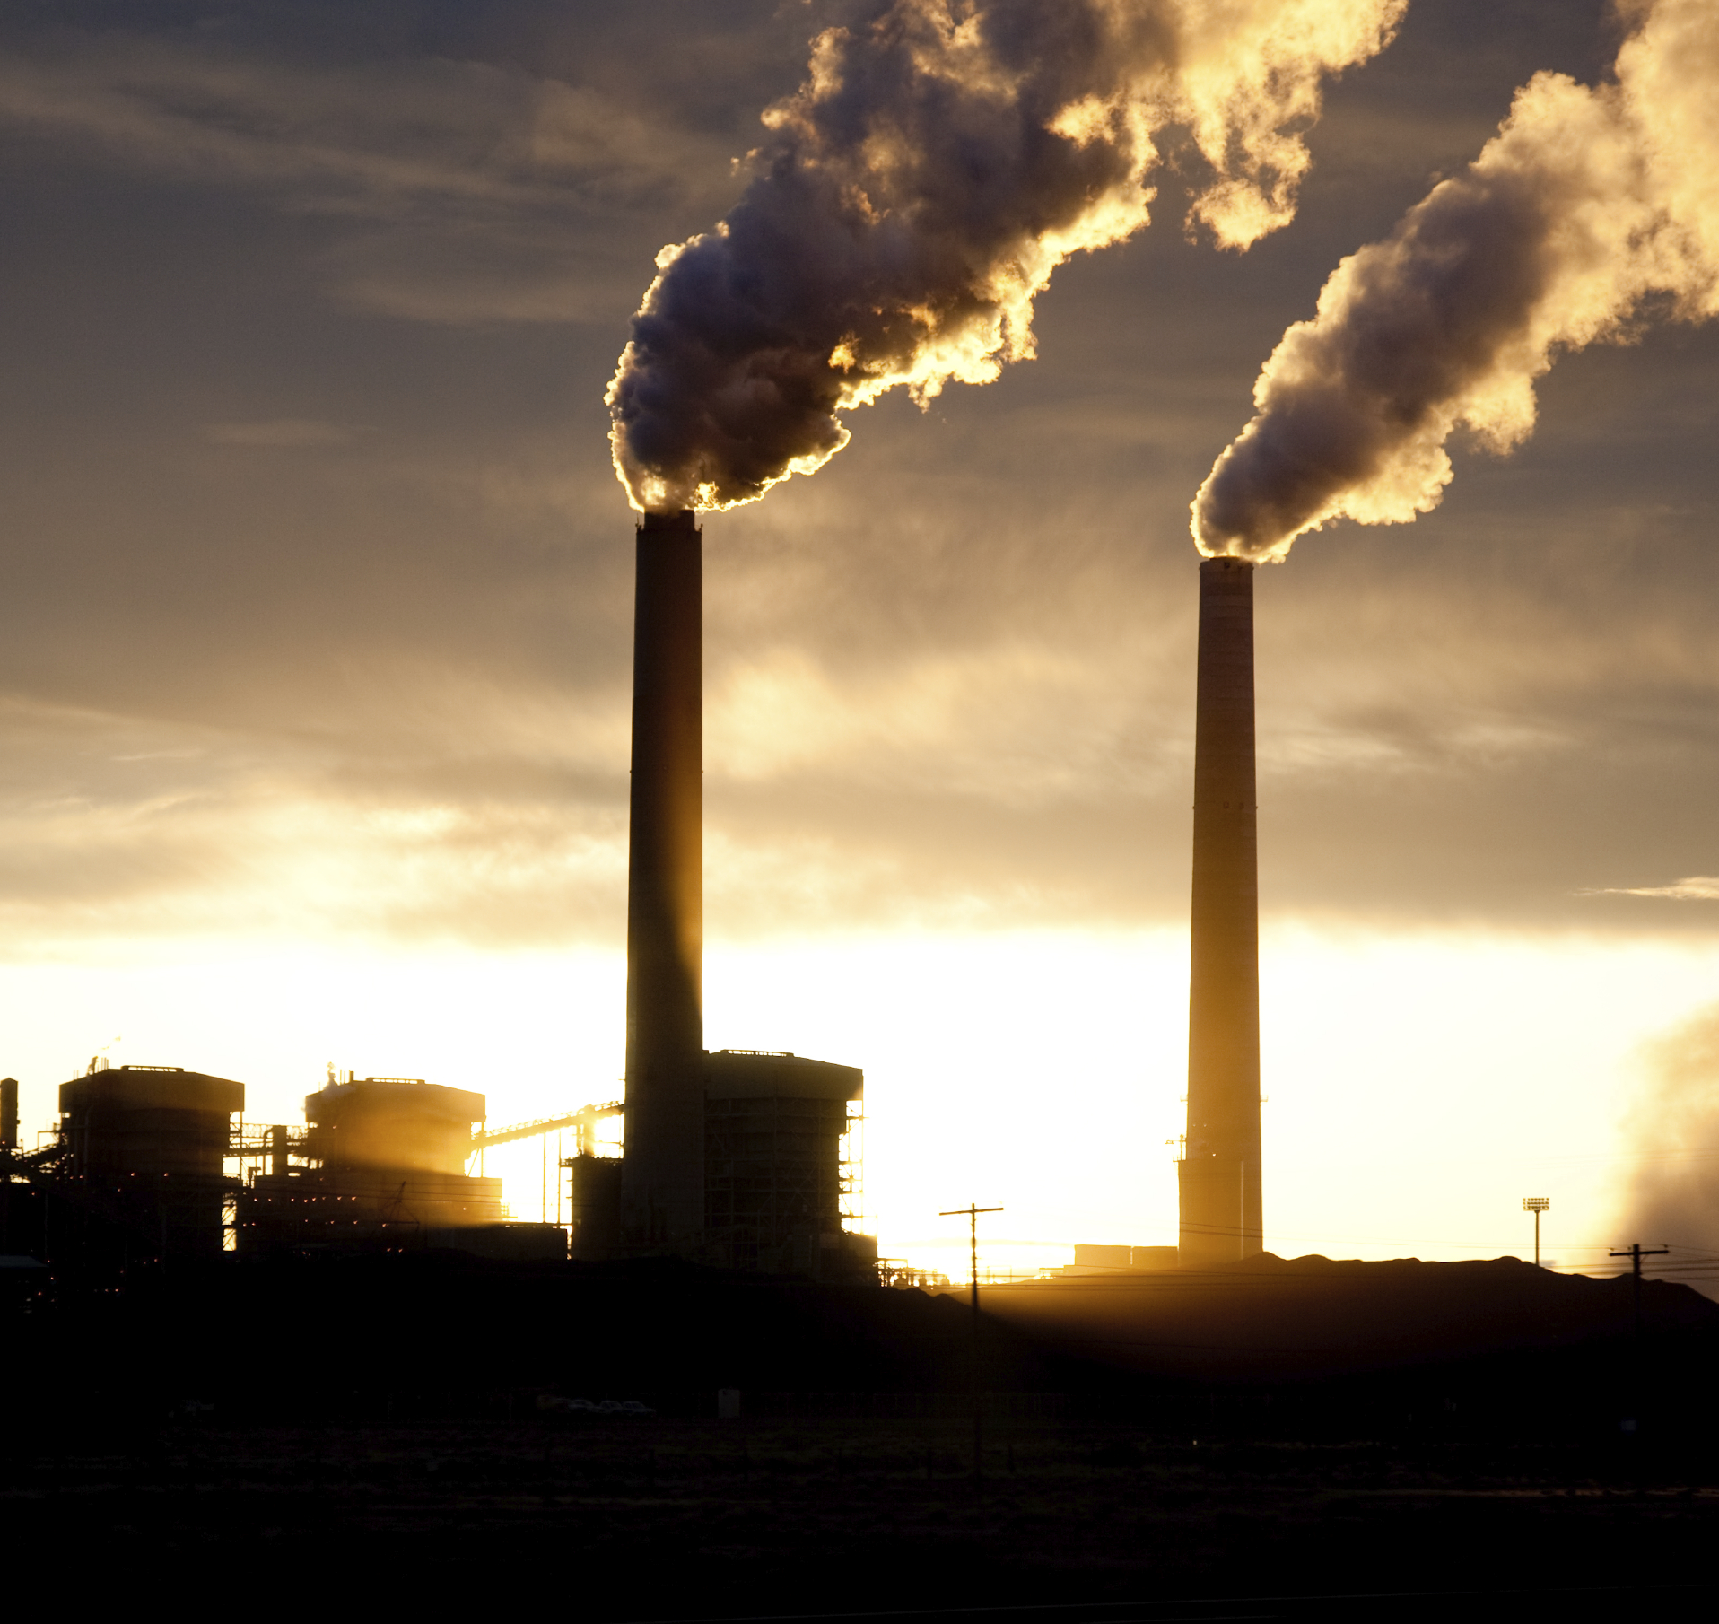
Humans and Climate Change
The IPCC Fifth Assessment Report (2014) concludes, with 95% certainty, that human activity contributes significantly to climate change.
Human activity in the last 250 years has sped up the warming process by releasing increasing amounts of carbon dioxide, methane and other ‘greenhouse gases’ into the atmosphere.
These are called ‘greenhouse gases’ because they act like a greenhouse trapping heat, preventing it from escaping into outer space.
[UN Photo]
Notes:
Teacher Notes:
‘Greenhouse gases’ allow the sun’s short-wave solar radiation to pass through the atmosphere to the earth’s surface. There it is transformed to long-wave terrestrial radiation which is blocked by ‘greenhouse gases’. Without this ‘greenhouse effect’ the earth’s surface would freeze each night.

Slide 9
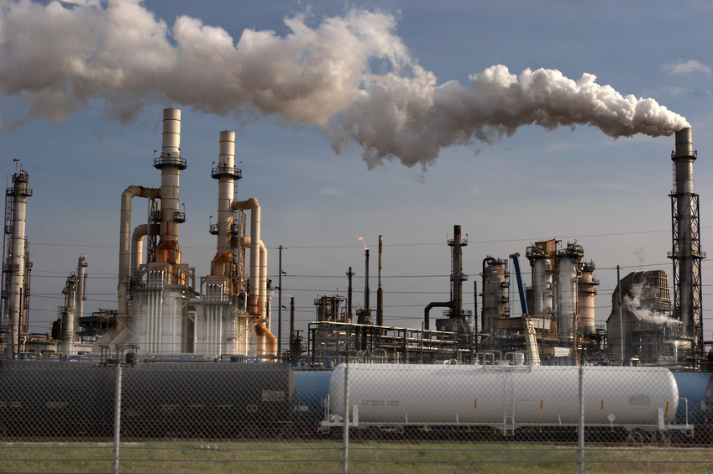
Humans and Greenhouse Gases
Rapid population growth of the last three centuries led to increased emission of ‘greenhouse gases’ (GHG).
People need food and the spread of agriculture results in trees being replaced with pastures and crops.
Trees absorb greater amounts of GHG. Livestock produce greater amounts of GHG.
Changes in technology have also led to human use of ‘fossil fuels’ that produce GHG.
[UN Photo]
Notes:
Teacher Notes:
The IPCC Report concludes that ‘greenhouse gases’ have increased to levels unprecedented in at least the last 800 000 years.
Students could research the reason for the term ‘fossil fuels’ and the types of fuels included in this term.
Students could differentiate between renewable and non-renewable energy sources.

Slide 10
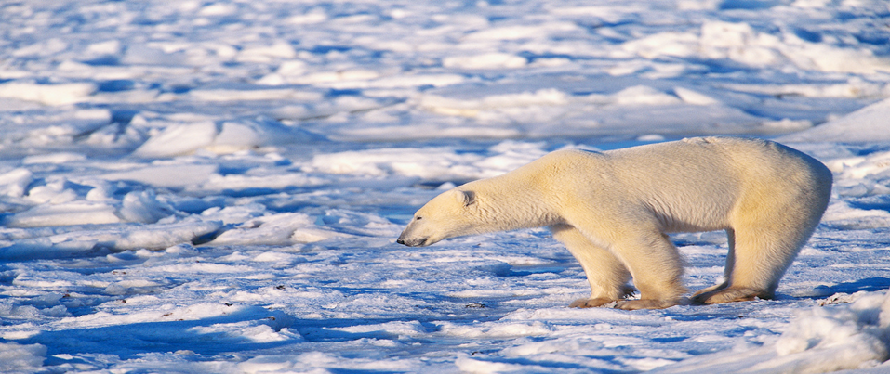
Environmental Impacts (1)
The earth’s atmosphere and oceans have warmed. Oceans have absorbed 90% of the increased energy.
Amounts of snow and ice have diminished. Polar ice caps and glaciers are shrinking.
Sea level has risen. (0.19 metres from 1901 to 2010)
Oceans absorb GHG and have become more acidic.
[UN Photo]
Notes:
Teacher Notes:
Students could brainstorm and discuss the likely environmental impacts on plants and animals. For example, what are the risks of the ocean becoming warmer and more acidic for plants and animals?

Slide 11
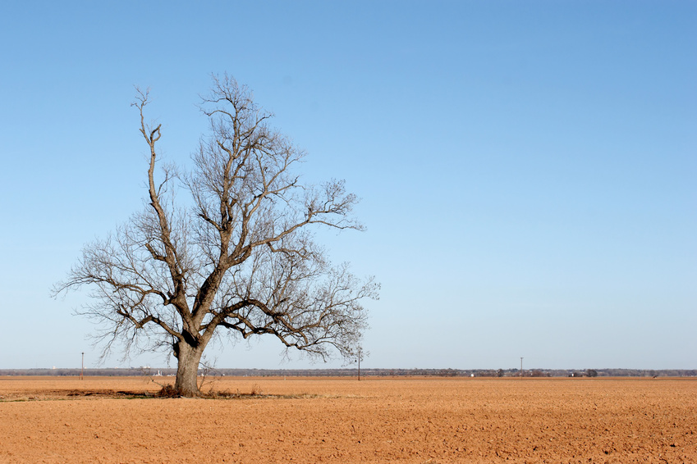
Environmental Impacts (2)
The earth is getting warmer faster than humans, plants and animals can adapt.
We experience more extreme weather events such as cyclones and drought.
Changes in the global water cycle are not uniform – some places will be wetter, others drier.
[UN Photo]
Notes:
Teacher Notes:
Students could research why rapid warming of the earth’s atmosphere contributes to more extreme weather events.

Slide 12
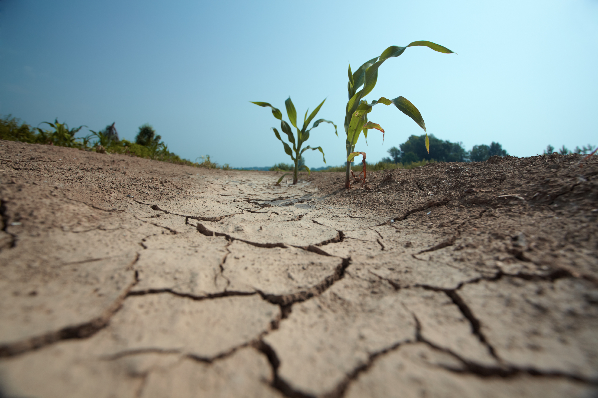
Environmental Impacts (3)
Overall, there will be reduced world food production.
Reduced crop yields and higher food prices will have the greatest impact on poorer people.
Destruction of buildings and transport infrastructure will increase in some areas prone to flooding.
Increased conflict for land and food resources is a risk.
[UN Photo]
Notes:
Teacher Notes:
Students could research and discuss the possible consequences of decreasing world food supplies, loss of land to flooding and ocean inundation.

Slide 13
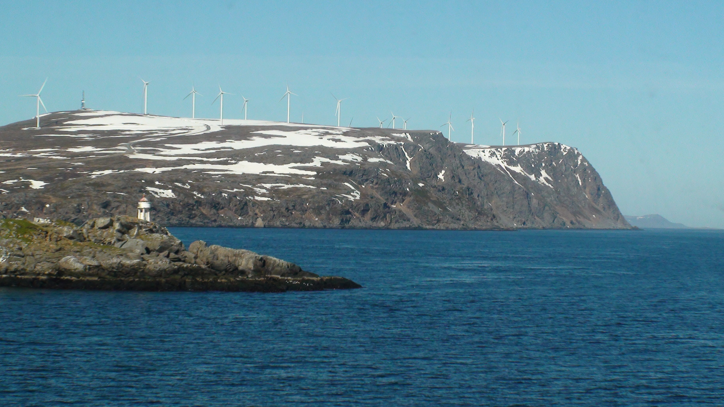
Limiting Global Warming
Scientists agree that limiting global warming to 2⁰C above pre-industrial levels will reduce the risks.
GHG emissions will need to be lowered to 40 to 70% of 2010 levels by 2050 and to near-zero by 2099.
This requires new technologies, changing energy production and land use. Reducing deforestation and planting trees will also reduce emissions.
R D Barrett
Notes:
Teacher Notes:
Students could research the types of actions being considered and implemented in Australia and other countries.
Photo:
Wind turbines, Norway

Slide 14
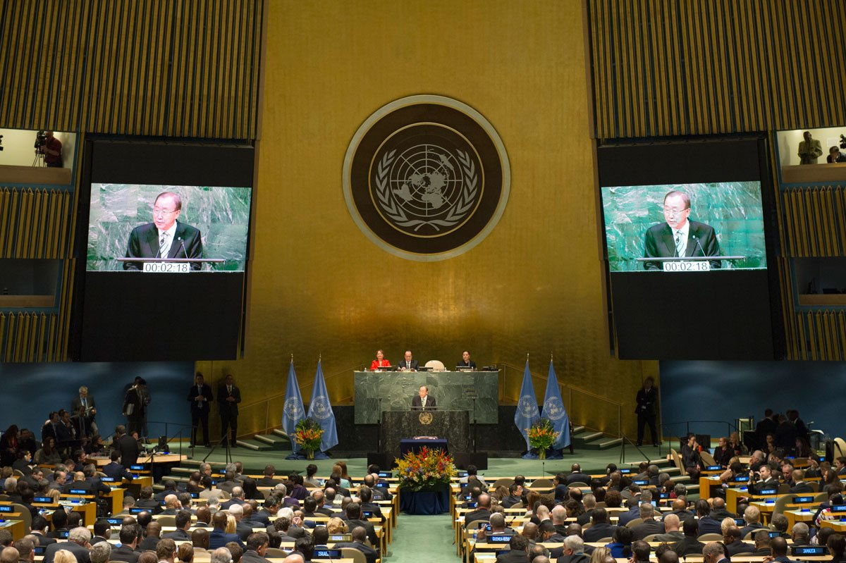
What is the UN doing? (1)
The United Nations has been working to achieve international agreement on climate change since 1979.
It led negotiation of the Kyoto Protocol (1997) which set legally binding targets and ‘market-based mechanisms’ for industrialised countries to reduce emissions of GHG.
The UN Climate Conference (Paris, December 2015) achieved a universal climate agreement mobilising global action.
[UN Photo]
Notes:
Photo: Ban Ki-moon addresses the Opening Ceremony of the High-Level Event for the Signature of the Paris Agreement. UN Photo/Rick Bajornas
Teacher Notes:
Students could research the Paris Agreement and identify the commitment that Australia has made.

Slide 15
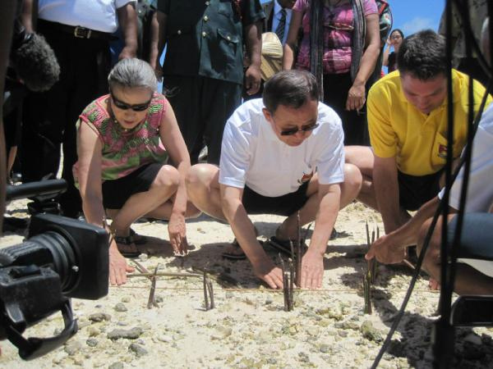
What is the UN doing? (2)
The UN System supports ambitious action on climate change through a range of programs. For example:
2014 UN Year for Small Island Developing States – raising awareness of nations vulnerable to climate change (rising sea levels, extreme weather events).
Environmental direct action such as planting mangroves to provide habitat for fauna and a buffer for rising sea levels.
[UN Photo]
Notes:
Source: UN website - Teacher Notes:
Teacher Notes:
The greatest concern related to Small Island Developing States relates to rising sea level resulting from global warming.
Low lying nations like Kiribati are already feeling the impact of comparatively small rises in sea level. Families have lost their land and been forced to move their homes.

Slide 16
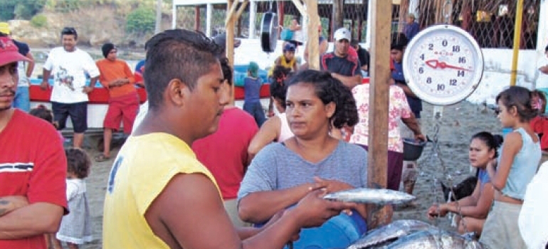
What is the UN doing? (3)
The UN showcases ambitious projects. For example:
Livestock Waste Management in East Asia Project
Sustainable fisheries and aquaculture in Nicaragua
Climate-smart agriculture project in Zambia
1 Million Women Initiative in Australia
Bamboo Bicycles Project in Ghana
[UN Photo]
[UN Photo]
Notes:
Source: UN website – http://www.un.org/climatechange/success-stories-2/
Teacher Notes:
Students could research any of these projects through the above web link. For example, the 1 Million Women organisation in Australia “aims to get one million women to pledge to take small steps in their daily lives that save energy, reduce waste, cut pollution and lead change. Since its creation in 2009, the organization has become the largest women’s environmental organization in Australia, with nearly 83,000 women having joined the campaign, and members have committed to cut over 100,000 tonnes of carbon pollution”.

Slide 17
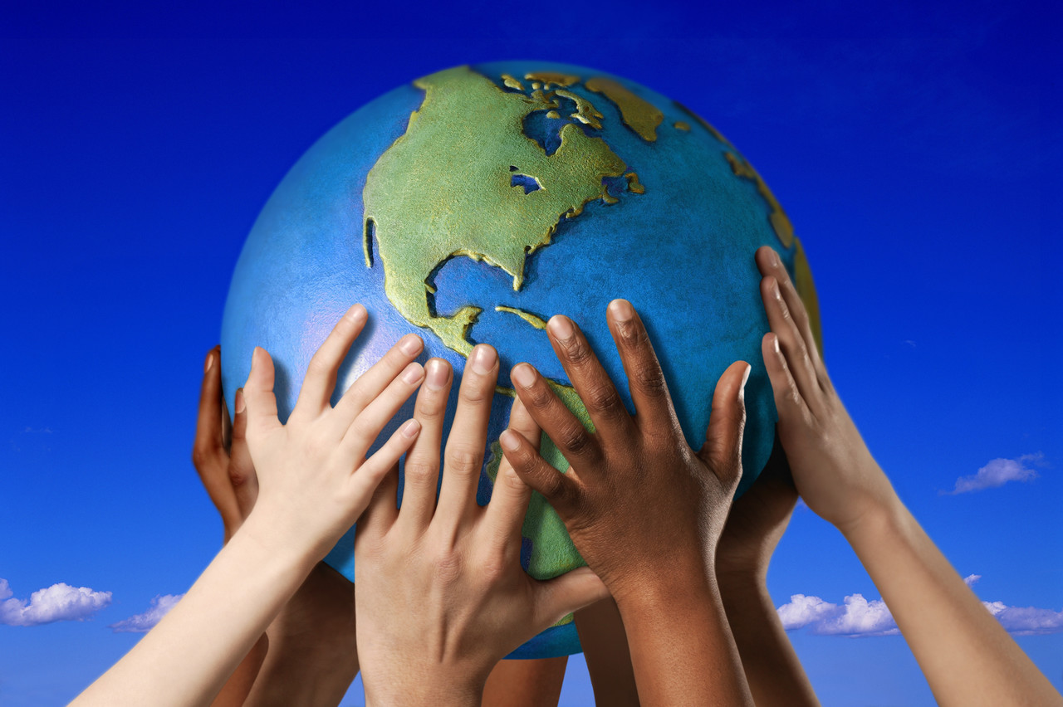
What can we do to help?
[UN Photo]
Notes:
Teacher Notes:
Students could brainstorm the actions that individuals could take. For example:
Learn more about climate change and why nearly all climate scientists are concerned about it.
Find out why this is a controversial political issue and how it is currently being handled in Australia.
Audit energy usage in their home and school and act to reduce it.
Participate in tree planting schemes in the local community.

